Slide 1
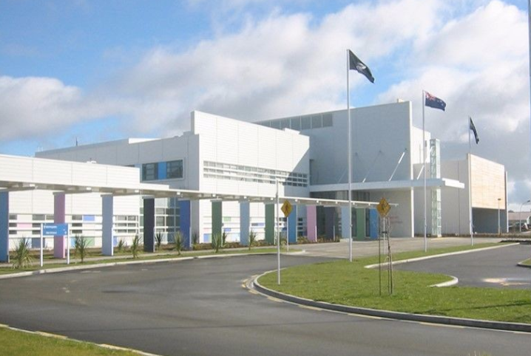
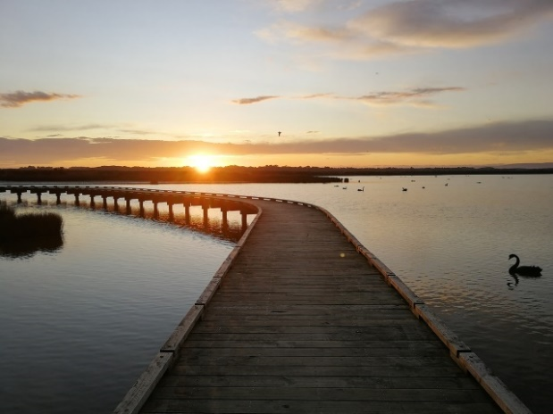
Welcome to Southland Hospital
Dr Kathryn Forwood, Dr Adam McLeay, Dr Kayla Gardyne, Heather Wicks & Rhonda Skilling
Notes:
? Kathryn to open? I am happy to if need be
Introduce the team and their roles

Slide 2
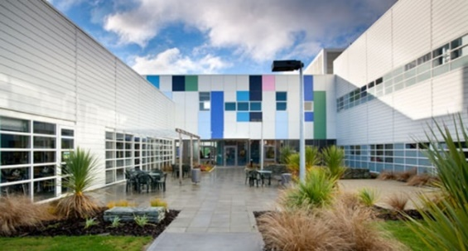
About Us
Here at Southland Hospital, your professional life is easily balanced with all that Invercargill and the surrounding areas have to offer. You will enjoy a clinically challenging, training focused and rewarding job combined with a relaxed and satisfying lifestyle.
As a secondary level base hospital, our staff enjoy a broad range of cases which provides good opportunities for those starting off in their careers to gain a wide experience and exposure to clinical cases.
In addition to offering an innovative and progressive working environment, Southland Hospital is small and intimate enough for new arrivals to quickly get to know those they work with as well as their patients. This is modern medicine practised in the most personalised way possible.
Southland Hospital services a 108,000 population base providing acute medical and surgical care, outpatient clinics, day procedures, 24-hour emergency department and comprehensive ancillary facilities. On average per year at Southland Hospital there are 30,000 Emergency Department attendances, 5,000 theatre operations and 17,000 discharges.

Slide 3
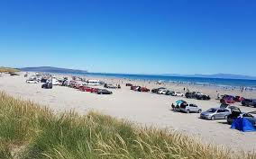
Living in Invercargill
Living and working in the southern most city in New Zealand, is pretty damn great! Whether you prefer city life or residing in a rural area, the opportunities to follow your lifestyle dream are endless!
We are proud of our café culture with great places to pass the time. For the serious ‘foody’, there are a number of restaurants that will deliver food to your table that is absolutely sublime.
For those who love beach life, visit Oreti Beach. Here, not only will you find surf and sand but a large number of sports clubs who would love to meet you! Feel like a drive? Then take to the beach!

Slide 4
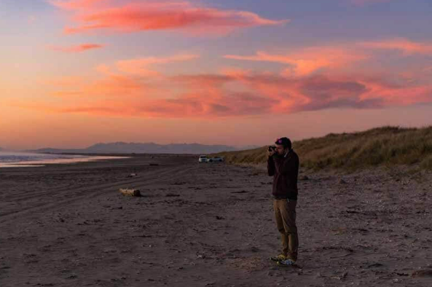
Living in Invercargill
Commuting within the city, or to the surrounding areas, is a breeze! Choose to be close to the Hospital and have a 5 minute commute or if you prefer the rural life, no worries! You’ll easily be able to get to the Hospital within 10 – 20 minutes!
Like to exercise? The opportunities are boundless! Walk through Queens Park, cycle around Pleasure Bay Lagoon or mountain bike through the Sandy Point Trails.
Feel like travelling further afield? Take a quick boat ride to Stewart Island. Jump in the car for a meander around the fabulous Catlins. Or, head several hours up the road to the adventure capital that is Queenstown.
Whatever your preference, Invercargill is perfect for you!

Slide 5
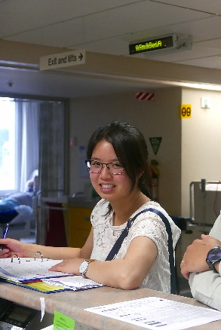
About the Role
Kayla will tell you more about the role soon and from a House Officers perspective.
In the meantime……
Our available PGY1 runs consist of the following:
General Medicine
General Surgery
Orthopaedics
AT&R (after the completion of 6 months)
Our PGY2 and SHO runs consist of:
The above runs
O&G (6 months)
Paediatrics (6 months)
ED (6 months)
Psychiatry
ED / Trauma Orthopaedics (6 months)
Community Based Attachments
Reliever
House Officers are asked for their run preferences and where possible, runs are allocated as such.
Registrars will be working in all of the above runs excluding Psychiatry and AT&R.
Notes:
PES – discuss basis and process for run allocation
1 – seeking run preferences
2- allocation
3 – approval by PES and MD
4 – circulation to CDs
5 – finalising

Slide 6
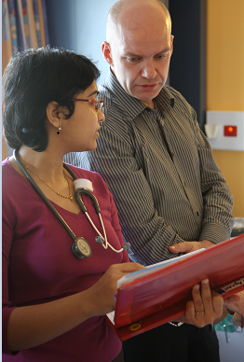
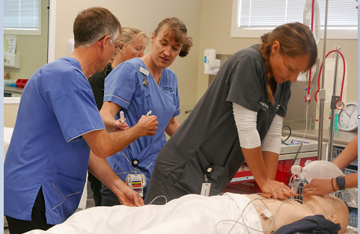
About the Role
House Officer rostered hours vary slightly depending on the run however, will mostly be:
Monday – Friday 0800 – 1600 ordinary hours
Monday – Friday 1600 – 2000 (Medicine long day) or 1600 – 2300 (surgical long day)
Weekends – 0800 – 2030
First year House Officers will be rostered to night duties after 6 months experience. These are likely to be
Monday – Friday 2230 – 0830
Weekends 2200 – 0830
Regular formal and informal teaching is always on offer. Formal House Officer teaching takes place Thursdays 1300 – 1400. Departments also run sessions and will advise their House Officers of these at the service induction.

Slide 7
Key Supporters
Support for House Officers at Southland Hospital can be found everywhere and including from:
Prevocational Educational Supervisors (Drs Claire Shadwell, Adam McLeay and Mavis Orizu)
Dr Kathryn Forwood, Medical Director Prevocational Education
The RMO Unit team
The Prevocational Educational Training and Management Committee
Unions
Team, or other, Registrars, Clinical Supervisors and Clinical Directors
Medical Directors
Service Managers
Charge Nurse Managers and the Nursing team
Southern DHB has a number of other options to find support such as:
Tuakana Teina Support
Speak Up
Vitae
Notes:
A number of support options available to all staff. Some of these are dedicated to the role however, there are others that are in place for all staff.
Southern DHB values set the expectations around everyone’s behaviour
Speak Up allows us to be supported through times of trouble. The Speak Up site has information on how to manage, who can help, as well as options
Vitae is a free counselling and anonymous counselling service to all employees

Slide 8
Career Options
Vocational Training occurs daily at Southland Hospital and we are accredited to train across a number of specialties. We have a number of opportunities for Rural Hospital Training also.
We regularly have trainees in the following:
Anaesthesia
General Medicine
General Surgery
Orthopaedics
O&G
Paediatrics
ED
House Officers in their second year are encouraged to undertake further training in the specialties they are interested in training in. The desire to undertake post graduate training should be discussed with, and endorsed by, the relevant Prevocational Educational Supervisor.

Slide 9
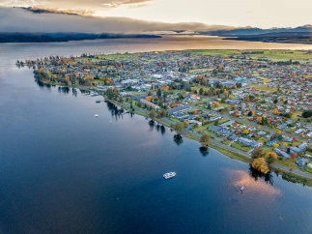
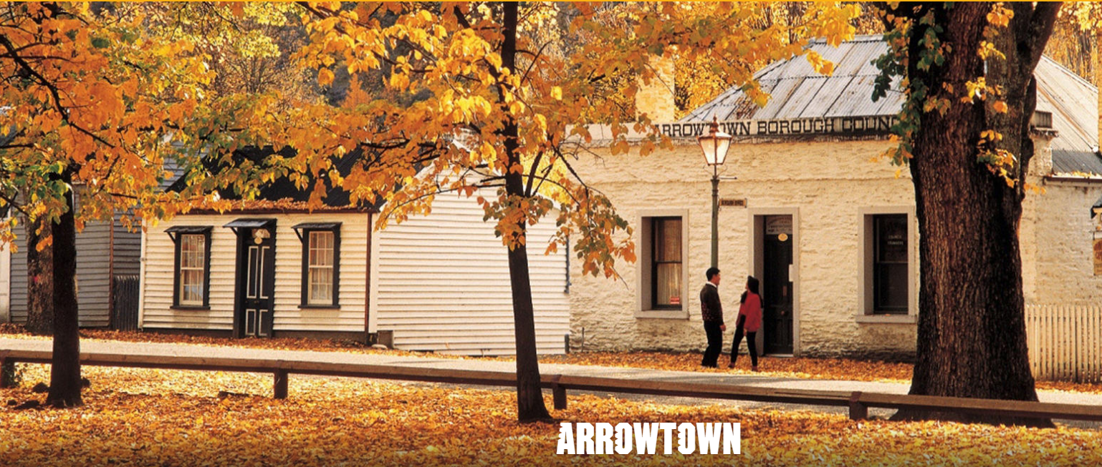
Additional Information
Check out other opportunities to Southland Hospital House Officers!
Community Based Attachments based in
Te Anau
Gore
Bluff
Opportunity to rent one of three Southland Hospital Holiday Homes in
Queenstown
Arrowtown
Te Anau
Get your work and contribution recognised at the Southern DHB Annual Excellence Awards
Gain access to our state of the art simulation and learning centre on the Hospital campus
Join in with some of the teams and events arranged by Hospital staff
And, of course…. Take us up on our offer of working with the fabulous, friendly people of the South!

Slide 10
Application Process & Selection
When applying for a role at Southland Hospital ensure you include:
A cover letter telling us why you want to be considered
If you are a Mirihiku Scholarship recipient, please make this clear in your application
You also may want to consider introducing yourself to one of the Prevocational Educational Supervisors and / or the RMO Unit
Our selection process is based on a number of aspects including:
Your references and so please choose your referees carefully
We score not only your clinical skills but also on professionalism and other behavioural components that contribute to being an excellent doctor
Your overall grades throughout medical school
Your story and why you would like to be considered to work at Southland Hospital
This can either be articulated via your cover letter or when you introduce yourself to one of those mentioned above
When you can start. We are happy to consider delayed starts but a number of factors may influence our ability to agree. Please ensure you discuss this with the RMO Unit team.

Slide 11
A Day in the Life of……
Introducing Dr Kayla Gardyne, House Officer

Slide 12
…A Southland PGY1
Medicine/AT&R
Surgical
All Gen-Med Teams have consultant General Medical Physicians at the helm, many of whom also have sub specialty additional training…
Respiratory
Cardiology
Renal
Endocrine
General Surgical Teams
Breast/Endocrine
Colo-rectal
Urology
Acutes
Orthopaedics

Slide 13
Work-Life
Medicine
Monday – Friday 0800 – 1600 ordinary hours
+ on average one medicine admitting shift/“long day” per week from 1600-2000hrs
1 or 2 times a quarter you do a week of “evenings”, Monday- Friday 1530-2300hrs
Surgery
Monday – Friday 0730 – 1600 ordinary hours
+ on average one “long day” per week 1600 – 2300
Weekends
Either 0800 – 2030 OR 0800-1600 “swing”
Nights
First year House Officers will be rostered to night duties after 6 months experience. These are likely to be
Monday – Friday 2230 – 0830
Weekends 2200 – 0830

Slide 14
Balance
Collegial
Supportive
Hands-on
Multidisciplinary Team
Free and available parking (!)
Café/lunch
In and outside of work social groups include:
Soccer/netball/run-club
“Thirsty Thursdays”
Escape the hospital…

Slide 15
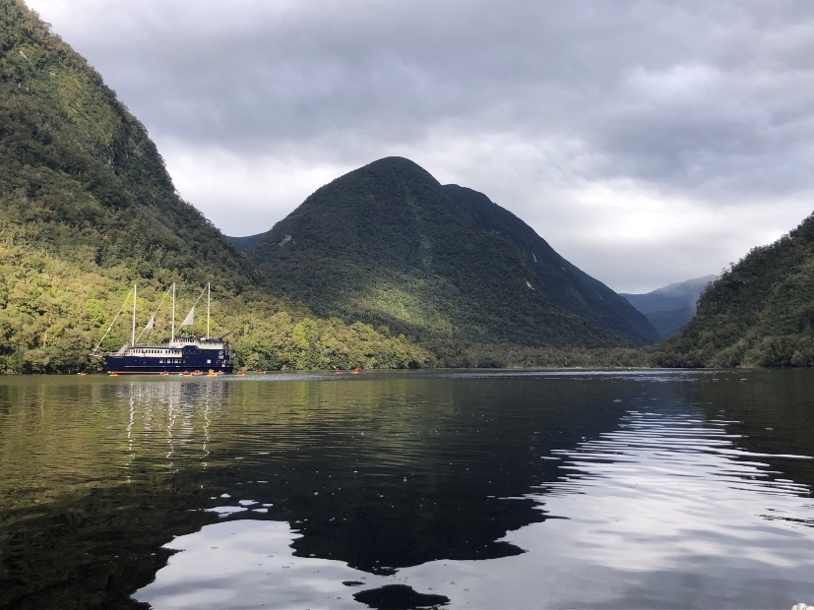
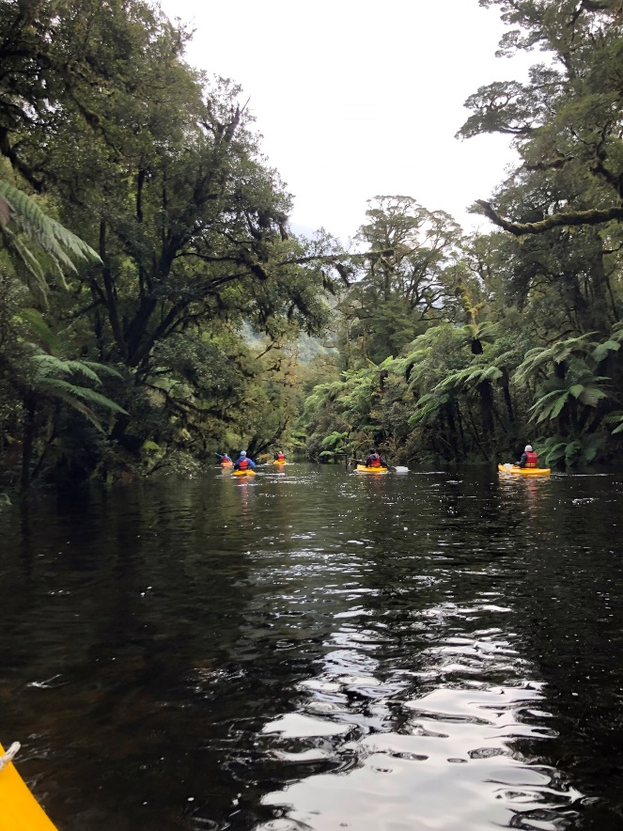
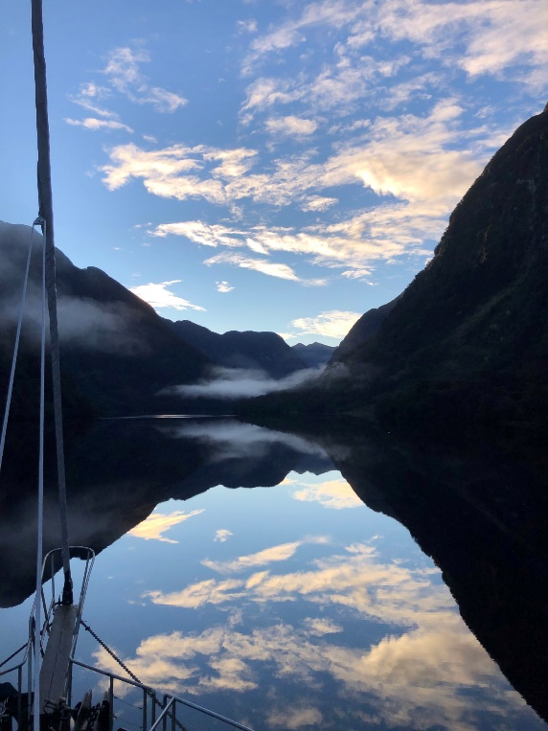
Doubtful Sound… whilst on RDO’s just 3 days ago!

